Slide 1
Olist
Ali Al Bassri
S.Qassim Mohamed
S.Hassan Al Hashimi

Slide 2
Problem Statement
Between 2016 and 2018, Olist in Brazil kept an average review score of 4.1, which is in the satisfied range. However, 11.5% of customers still gave 1-star reviews. This raises the need to understand what drove these negative experiences and what steps can fix them.

Slide 3
What are the different categories of customer reviews?
2- Unsatisfied
3- Neutral
4- Satisfied

Slide 4
Are customers satisfied with Olist's products and services?
A high percentage of customers are satisfied Olist's products and services. The overall Avg review score is 4.1.

Slide 5
Are we performing well or poorly in terms of customer satisfaction?
There are efficiency and inefficiency (areas of improvement) in achieving customer satisfaction

Slide 6
Which KPIs best measure satisfaction; NPS, churn rate, repeat purchases, complaints, or reviews?
The Best KPI to measure satisfaction is reviews

Slide 7
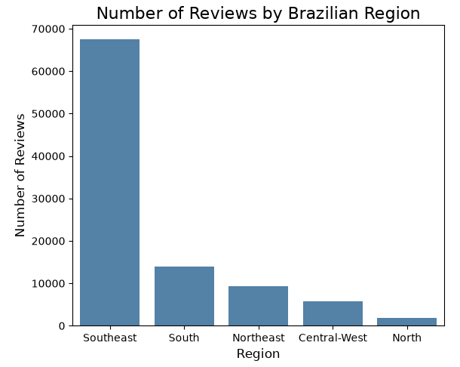
Where are highest and least reviews?

Slide 8
What are the 5 regions of Brazil?
Central west - population 14 million
Southeast - population 85 million
South - population 28 million
Northeast - population 56 million
North - population 18 million

Slide 9
Demographics
Median age in Brazil sits at approximately 35 years in 2026
Approximately 88 percent of Brazilians live in urban areas

Slide 10
how can we improve customer experience and satisfaction?
According to comments
deliver the item within the deadline
deliver all ordered items
Better communication with customers regarding latest updates
Improve quality and good packaging of product

Slide 11
What percentage of customers are highly satisfied, neutral, or unsatisfied?
57.8 % are highly satisfied
8% are neutral
11.4% are unsatisfied

Slide 12
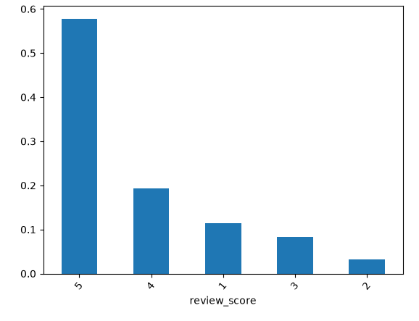

Slide 13
Ali Al Basri

Slide 14
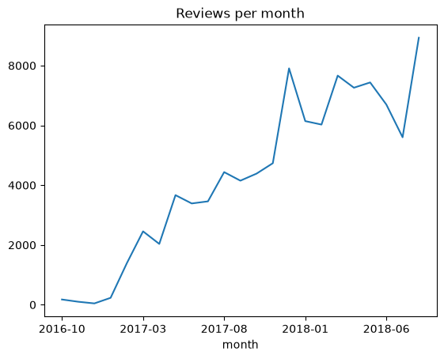
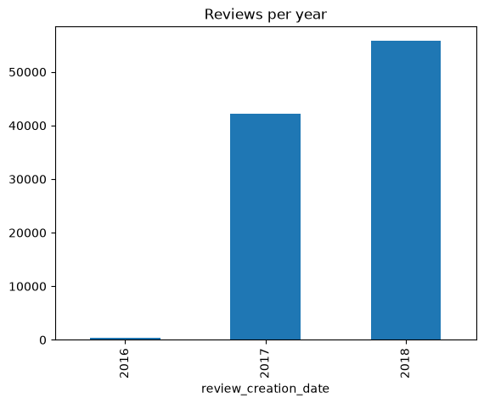
How many reviews were given per year or per month?

Slide 15
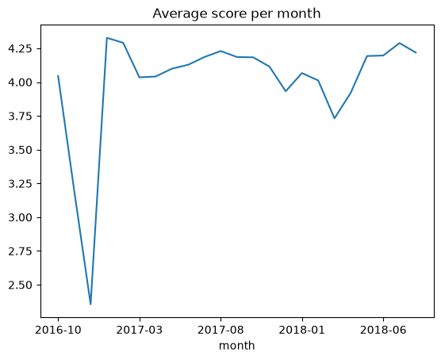
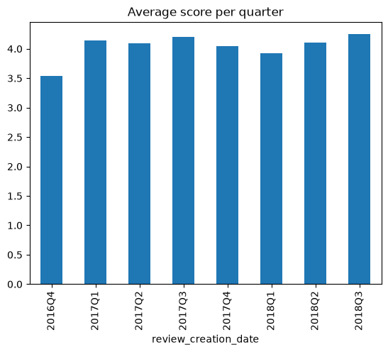
-What is the average customer review score (overall, monthly, or quarterly)?

Slide 16
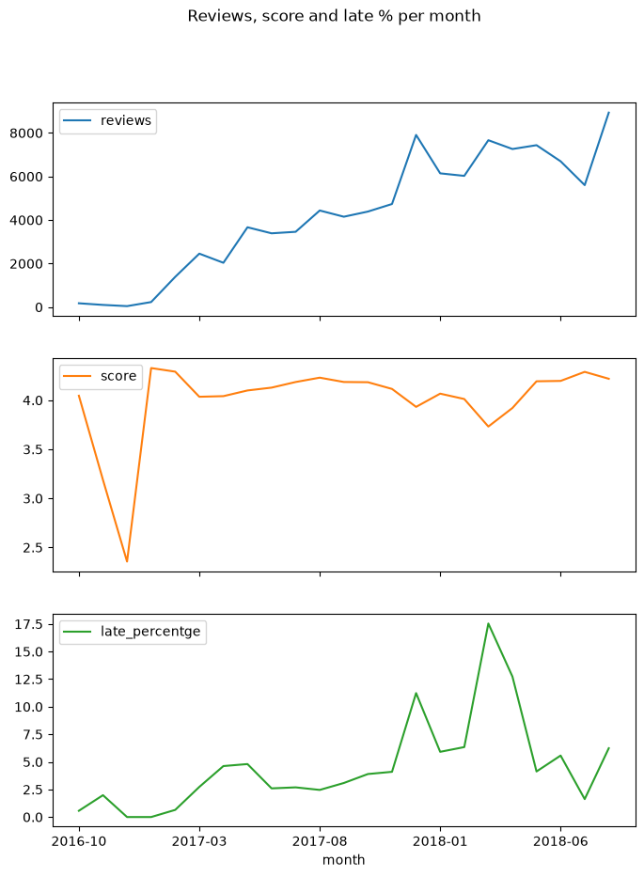
Why is there a drop in average satisfaction or reviews in December 2016 and between Oct 2017–Feb 2018?

Slide 17
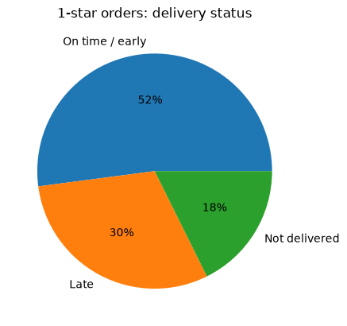
-Why are some customers rating Olist 1 star (high dissatisfaction)?

Slide 18
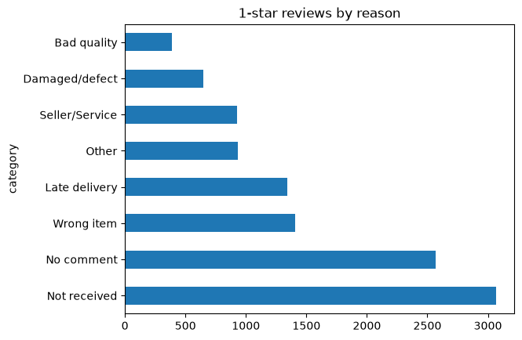
-How can we convert "highly unsatisfied" customers into satisfied ones?

Slide 19
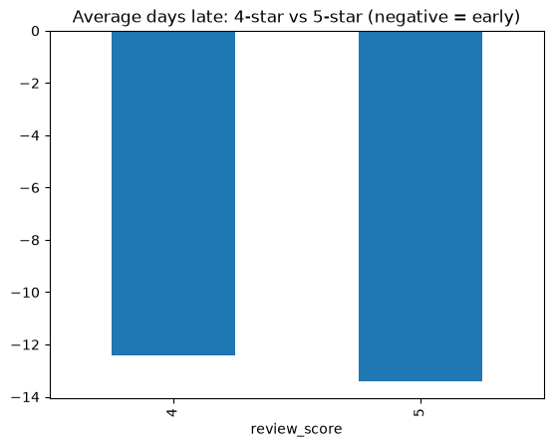
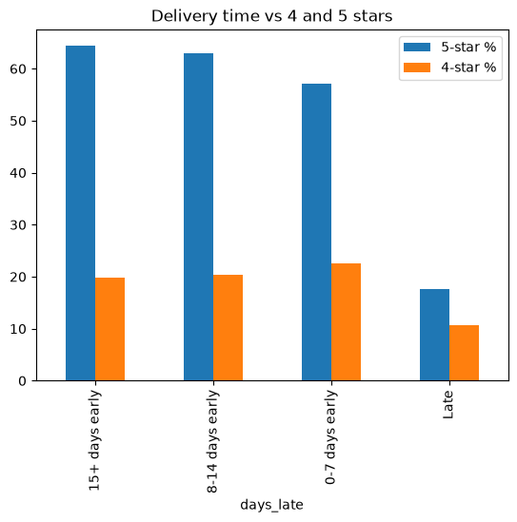
-How can we improve 4-star reviews to 5 stars?

Slide 20
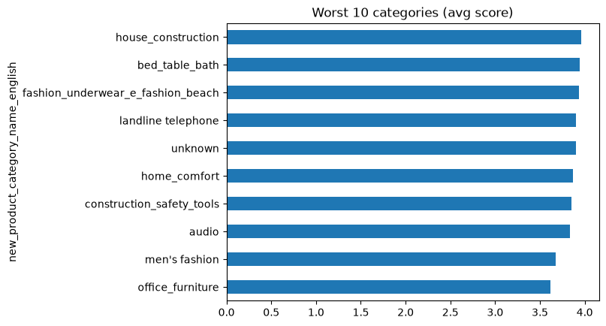
-What categories or sellers are linked to low review scores?

Slide 21
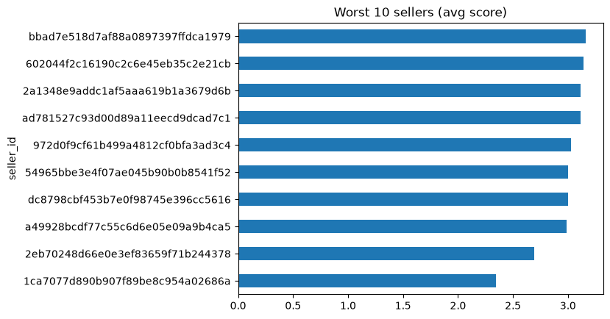

Slide 22
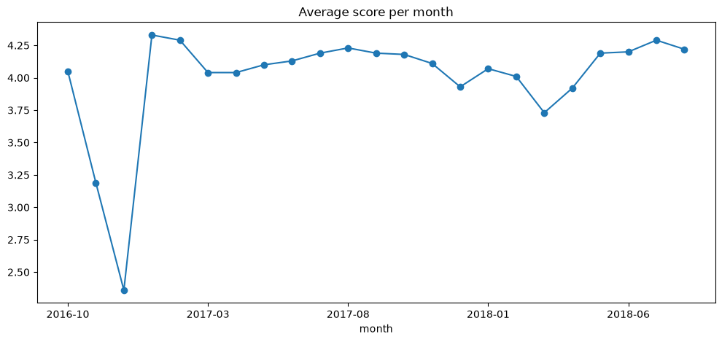
Are there patterns of low satisfaction in specific months, categories, or sellers?

Slide 23
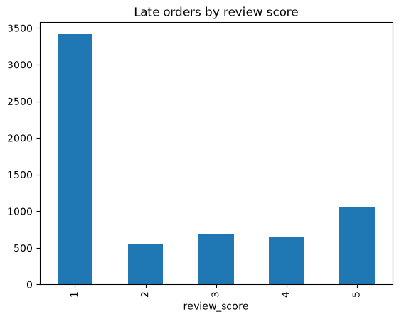
How many customers are satisfied despite late deliveries, and how many are not?

Slide 24
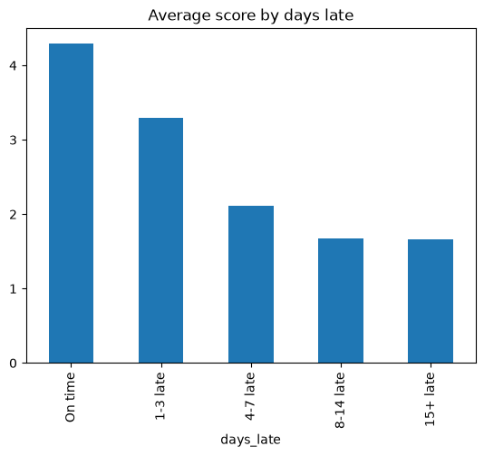
Does late delivery cause low reviews, or are there other factors involved?

Slide 25
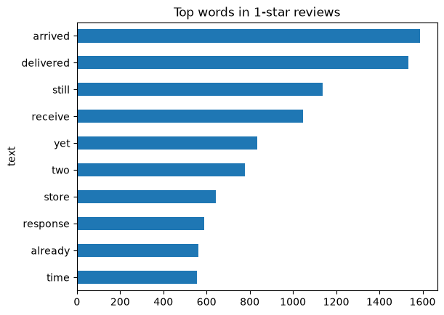
What are the top 5 most common negative keywords in 1-star reviews?

Slide 26
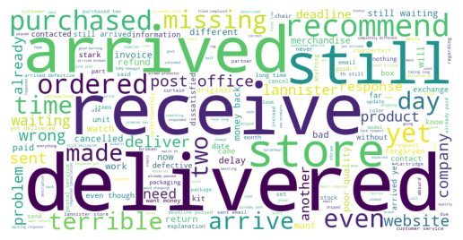

Slide 27
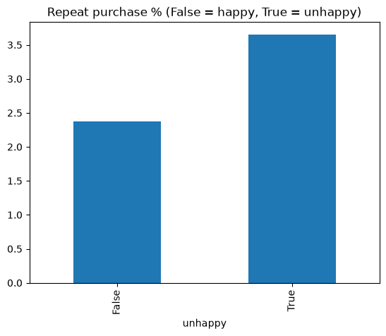
Do customers who gave a 1- or 2-star review ever make a repeat purchase,

Slide 28
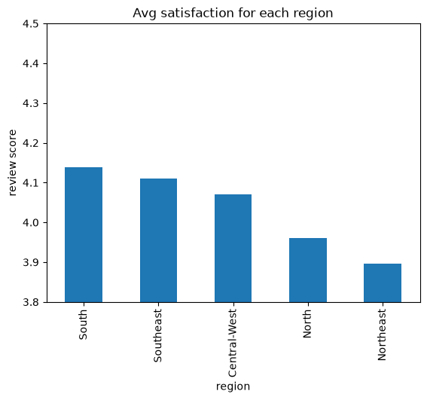
Which states or regions have the highest and lowest average satisfaction?

Slide 29
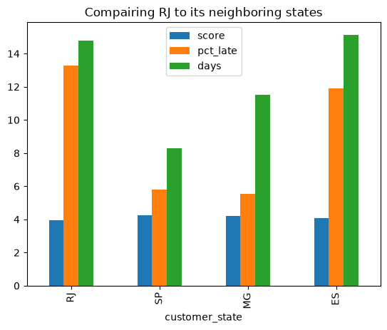
Why does Rio de Janeiro have a lower average compared to its neighboring states?

Slide 30
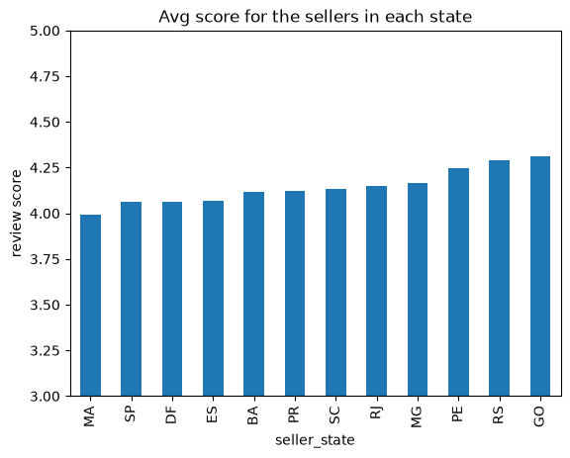
Which sellers or marketplaces have the lowest satisfaction scores?

Slide 31
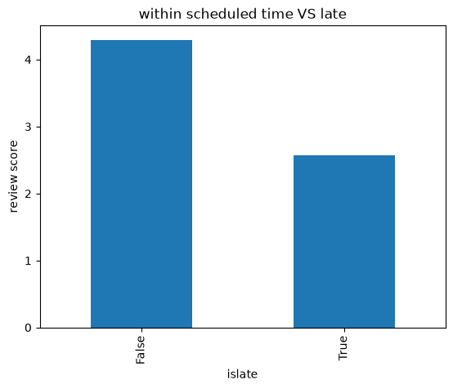
How does shipping or delivery performance affect satisfaction?

Slide 32
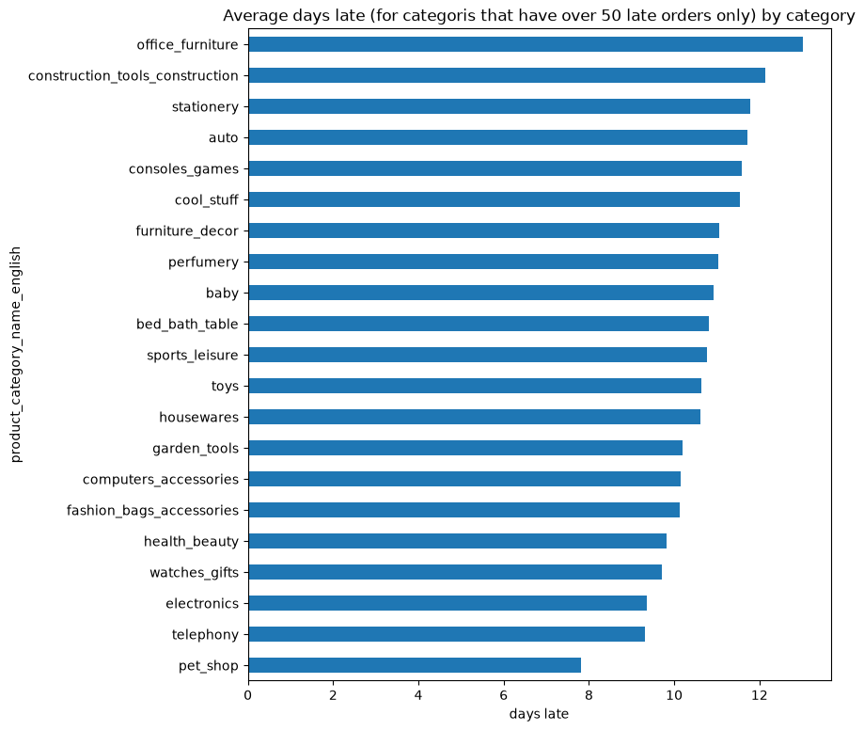
What are the average lateness days per order, and in which categories?

Slide 33
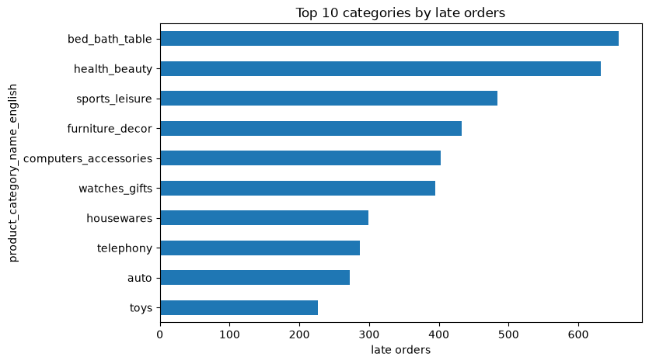
Which categories have the highest count of late deliveries?

Slide 34
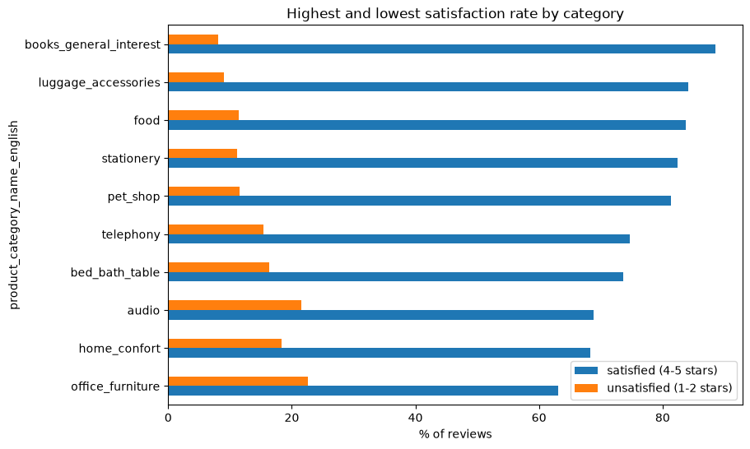
Which categories have the highest and lowest satisfaction rates (in % terms)?

Slide 35
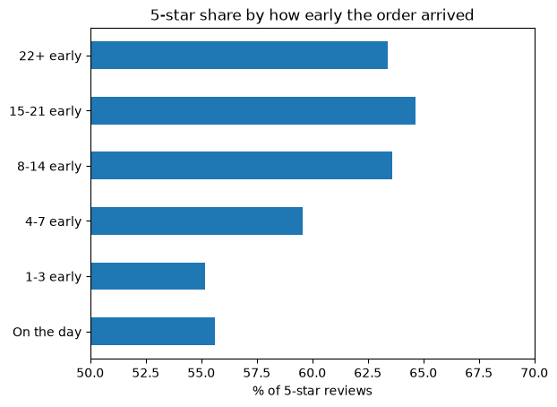
Does delivering earlier than the estimated delivery date significantly increase 5-star ratings, or is on-time delivery sufficient?

Slide 36
Conclusion
Delivery is the main problem. Of the 1-star orders, 18% were never delivered and 30% arrived late. "Not received" is the top reason in the comments.
Late delivery is not the only cause. 63% of the delivered 1-star orders arrived on time, so wrong items, damaged products, and poor seller service also matter.
Early delivery helps. 5★ reviews go up from about 55% (delivered on the estimated day) to about 64% (8+ days early).

